Slide 1
PEC Career Day
….and development with
Chuck Mahenski

Slide 2
The world of gaming
Video game companies collected a lot of gold coins in 2015. Total revenues for the industry in the U.S. hit $23.5 billion last year—a 5% jump over 2014. (Over a $100 billion globally)
"The high-energy, high-tech video game industry is rapidly producing some of the most valuable jobs in the U.S. economy," said Michael D. Gallagher, president and CEO of ESA.
Gaming is changing the way we do things. The way we interface with technology and everyday activities.
It’s FUN!!

Slide 3
Education & Internship Requirements
There are no set requirements, but most games designers are graduates. Most degree subjects are acceptable. However, individuals with a focus in Computer Science and/or Software Engineering is highly sought after.
Employers look for people with previous experience in the games industry - for instance as a games tester - and strong portfolios of relevant work. It may be possible to start on an Apprenticeship in QA and Games Production.
Most computer games designers train on the job. They may attend short courses on technological developments and new software packages. It is important to keep up to date with developments in technology and the games market throughout their careers.

Slide 4
What should I be learning now??
Reading is important:
It develops and broadens the mind.
It helps you develop your language skills.
It helps you learn to listen. Everybody wants to talk, but few can really listen.
It is how we discover new things.
Learn how stories are constructed.
Reading is fundamental in developing a good self image. Reading is important because words - spoken and written - are the building blocks of life.

Slide 5
What should I be learning now??
Writing
Writing improves communication skills.
Writing helps students review and remember recently learned material.
Writing helps educators assess student learning.
Writing encourages creativity and exploration.
Writing is essential for self-understanding.
Communication, both writing and verbal is probably your most often used skill once you get to the higher levels of game design. Coming up with a design is a pretty small part of the job. You spend most of the time communicating how to build that design to the rest of the team.

Slide 6
What should I be learning now??
Math is everything when it comes to games. From calculating the trajectory of an Angry Bird flying through the sky, to ensuring that a character can walk up a slope, slide down a slide, or even jump. Without the help of mathematics, games simply wouldn't work.
What are the main branches of math used in game development?
Algebra
Discrete Mathematics (algorithms, matrices, recursion, sequences, probability, etc)
Trigonometry
Calculus
Linear Algebra
Applied mathematics
And much much more....

Slide 7
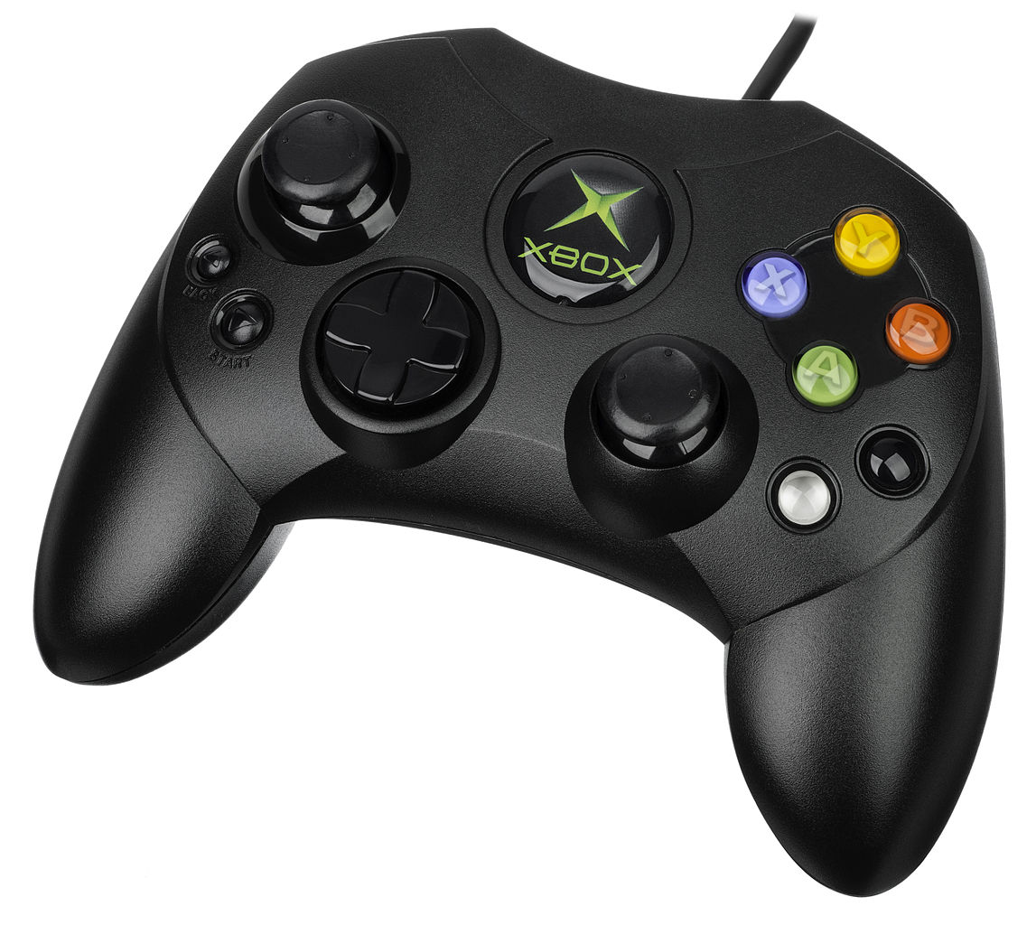
$$ Salary Ranges $$
Income can vary depending on:
Skill Level & Diversity
Experience
Location
Company Size
Market Demand
Target Demographics
Product Type

Slide 8
Basic Tools & Skills
These days as games get more complicated, the job often includes narrative elements in the areas of story/setting/characters. Design is a pretty broad term in the industry and it covers everything from high level system design (rules) to narrative design (story/character) to level design (the placing of assets and coding)
What tools do you have to learn how to use?
System designer/Creative Director - Most time spent in Excel, Word, and PowerPoint.
Narrative designer - Word, maybe Final Draft. These guys are mostly writers. Check out: http://twinery.org/
Level Designers - Excel, custom level design software or common 3rd party tools (Unreal, Unity, and so on) Typically should be comfortable navigating the popular 3D-art packages (3DMax/Maya)
Visual Studio IDE or others such as xamarin studio
Critical thinking, ability to break down a problem into a series of small discrete steps. It's not enough to play a bunch of games. You need to be able to clearly understand how the parts of those games work together. When/why they combine and work, and why they can fail when combined

Slide 9
Resources
Writing
http://twinery.org/ - an open-source tool for telling interactive, nonlinear stories.
https://sketch.io/sketchpad/
Groups
Game CoLab
IGDA
Graphic Art
https://pixlr.com/editor/
Blender
GIMP
http://pyxeledit.com/
Game Engines and Tools
https://scratch.mit.edu/
http://www.stencyl.com/
https://www.yoyogames.com/gamemaker
http://flowlab.io/
http://unity3d.com/
https://www.unrealengine.com/
25-essential-blogs-and-resources-indie-game-developers
Learn C# - http://www.learncs.org/
Learn C++ - http://www.learncpp.com/
Learn SCALA - Codacy

